Slide 1
Battle of the Neighborhoods
By Eugene Gluskin

Slide 2
Introduction/Proposal
A young chef, fresh out of Chef school wants to realize his dream and open a new restaurant in Toronto. He's facing two issues before opening his brand new restaurant
Which borough/neighborhood to open in?
What type of food to serve?

Slide 3
Data to be used
We’re going to use data from Stats Canada to determine which borough/neighborhood have the highest population (which means more customers)
We’ll also use data from FourSquare to determine most popular types of food being server

Slide 4
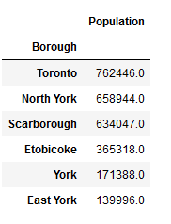
Borough Population
After cleaning up the data and analyzing it, it’s clear that the restaurant should be opened in Toronto since it has the highest population
North York and Scarborough are also good choices

Slide 5
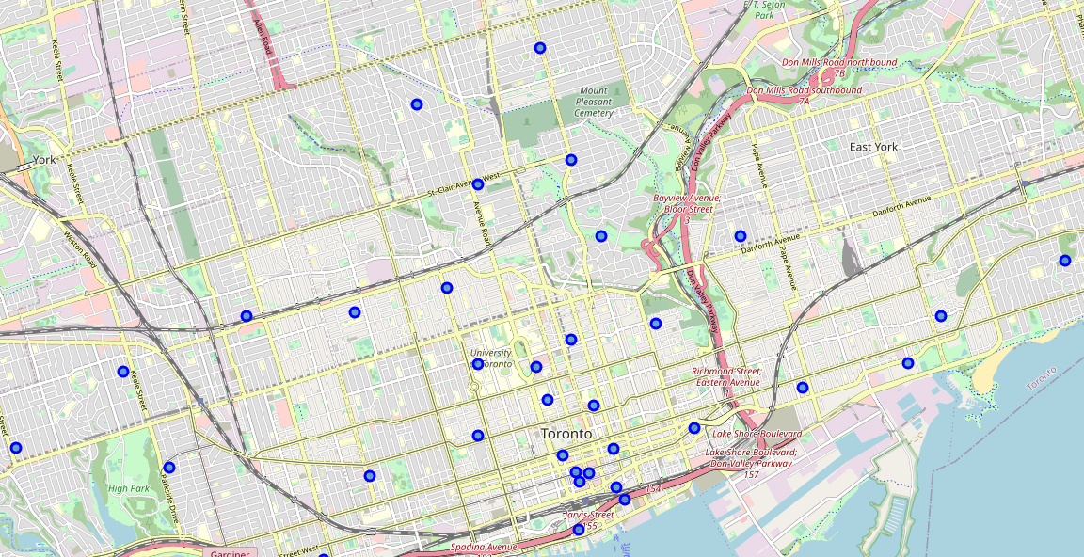
Map of Toronto

Slide 6
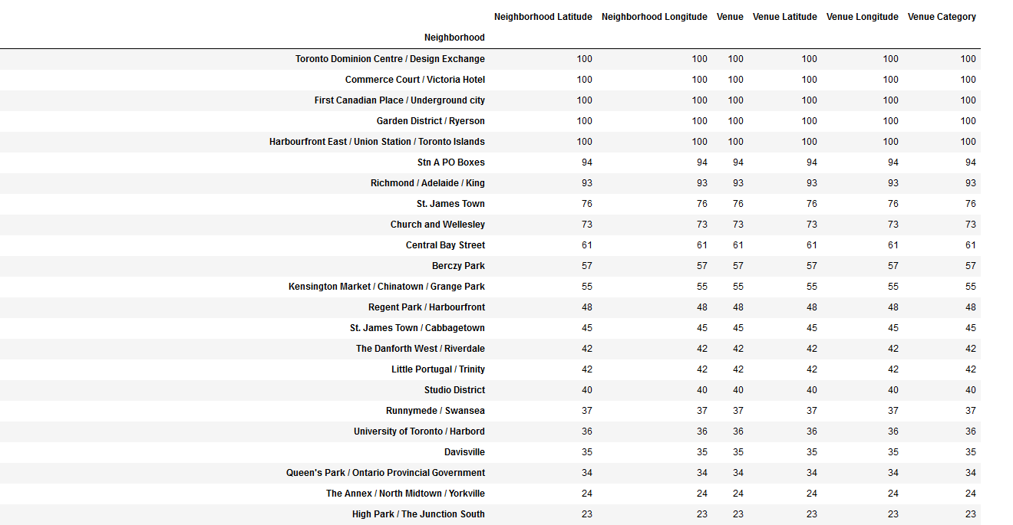
Toronto Venue Counts
Top neighborhoods have the largest amount of venues which make sense since it’s the downtown core which is filled with people living there and coming from other regions in GTA to work so lots of foot traffic

Slide 7
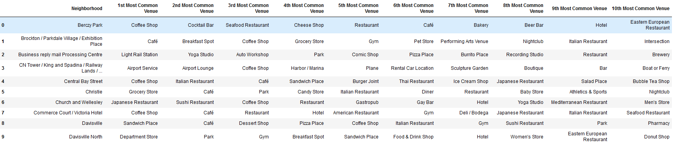
Most Common Venues
Top 10 most common venues for each neighborhood in Toronto
From an initial look, it appears that café and coffee shops are the most common venues in Toronto, especially in downtown core.

Slide 8
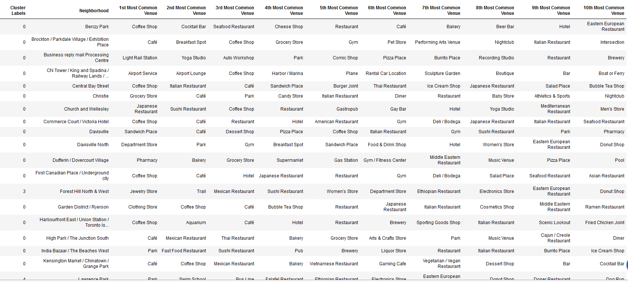
Clusters of Venues

Slide 9
Conclusions
Best borough to open a new restaurant is Toronto, since it has the largest population which would mean more customers
Downtown core has the most traffic and is in cluster 0.
Based on most common type of restaurant in that cluster, chef could open a café like restaurant since it appears people like to get things quickly on the go
Alternative is an Asian cosine such as Sushi, Thai, etc..

